Slide 1
WISE Pathways Learning Community
Community Engagement

Slide 2
Community Partner Role In WISE Pathways
Participant Recruitment
Program Support
Follow Up Services

Slide 3
Participant Recruitment
Method: Community-based organizations serve as trusted voices in the community- especially for already marginalized groups. Identifying aligned community partners can support recruitment efforts through providing connection. If you are piloting your program- running WISE Pathways in partnership with the community-based organization can help to build momentum.
Best Practices:
Adapt WISE Pathway curriculum to address the needs of the audience
Identify partners with similar goals and service populations
Find ways to create mutual benefit for partnerships

Slide 4
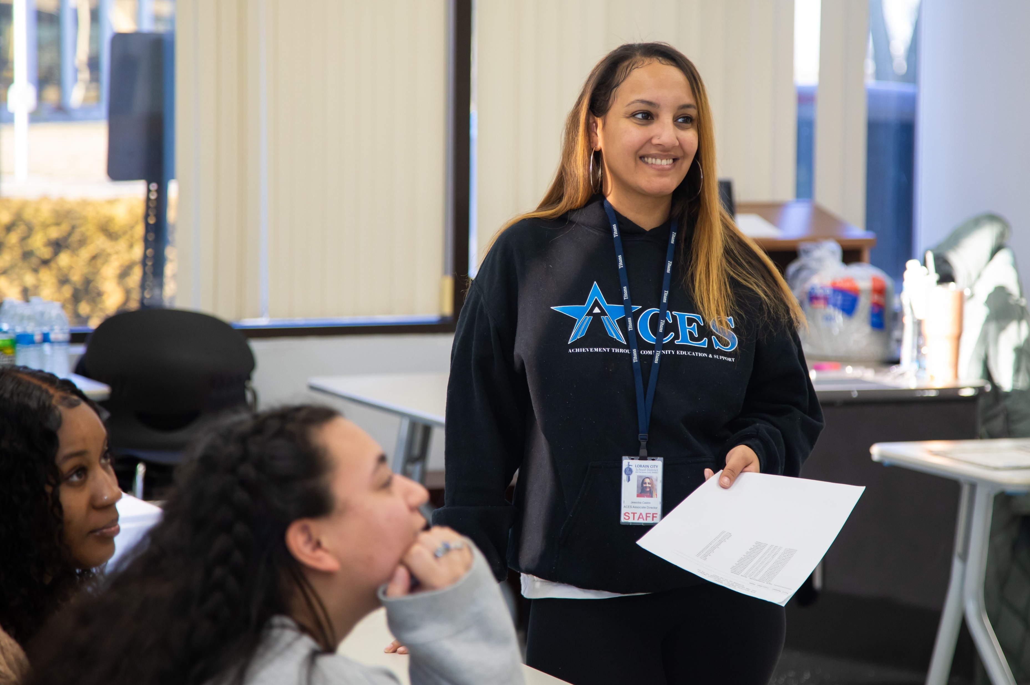
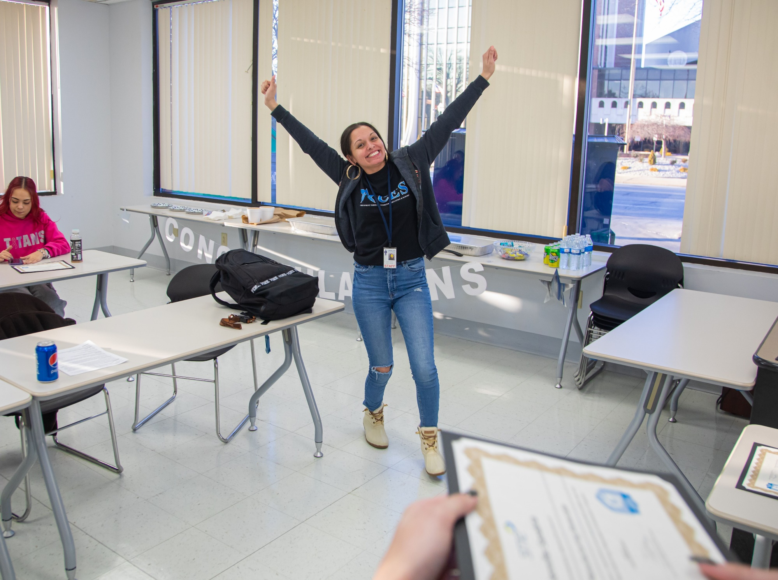
Case Study- Lorain County Community College and Achievement through Career & Education Success (ACES)
Participants included high school juniors and seniors, and recent graduates
100% of participants earned a Certified Manufacturing Associate credential from ToolingU
HHW Ohio is working with the Lorain County Manufacturing Sector Partnership to organize summer internships and work experiences for program completers

Slide 5
Program Support
Method: Community-based organizations can provide program support and wrap around services to participants. Depending on the needs of your participants program support can include follow-along case management, transportation assistance, childcare, or meals. Additionally, community-based organizations can deliver custom content including financial literacy/planning, mental health, or sexual harassment/legal council.
Best Practices:
Identify needs of participants before the start of the program to determine which services would be most helpful
Work with community-based partners to determine if it is possible to braid funding/co-count participants for grants

Slide 6
Follow Up Services
Method: The goal of WISE Pathways is to provide a warm handoff for each participant to help them on their next step. Many times participants will be ready to enter into education, training or employment- but sometimes they might require additional support. Community-based partners can help provide follow up services for those participants who need additional help. Common partners include ASPIRE, ODJFS/OMJ, mental health service providers, and Community Action Agencies.
Best Practices:
Work with participants throughout WISE Pathways to determine what additional needs they might have.
Bring in partners before graduation to facilitate an in person meeting.
Work with partners to identify any eligibility requirements and solve for those before the end of the program.

Slide 7
Share your story
How have you partnered with community-based organizations?
Who are partners in your community that you can engage? How might they support your program?

