Slide 1

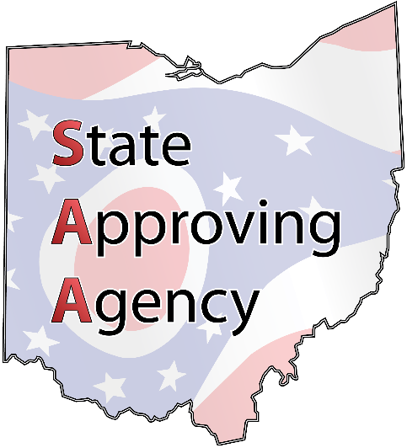
State Approving Agency
Our mission is to approve education and training programs for veterans and their eligible dependents throughout the state of Ohio.

Slide 2
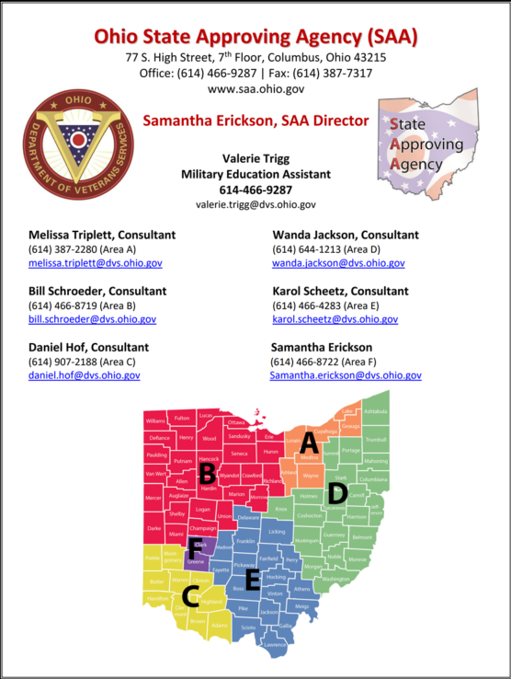
Roles & Responsibilities:
State Approving Agency
Program approvals/revisions
Risk Based Surveys
Technical Assistance
Outreach

Slide 3

Roles & Responsibilities:
Education Liaison Representative
Liaison between SCO’s and VA
Assists with certifying and Enrollment Manager
Processes approvals from SAA

Slide 4

Roles & Responsibilities:
School Certifying Official
Submit enrollment status in Enrollment Manager or paper VA 22-1999b & VA 22-6553d-1
Remain knowledgeable of VA rules and benefits
Maintain records of VA students
Submit required paperwork to SAA approval

Slide 5
Program Approval & Revision Process
Education consultant reviews documents and uploads them to Eforce with the VA
VA checks for compliance, updates WEAMS
Submit required documents
Catalog, policies, VA forms, SAA forms, accreditation, etc
ELR sends school WEAMS report
SCO can certify students in programs listed on WEAMS report

Slide 6

Program Approval & Revision Process
Types of approvals/revisions:
Initial approval
Wage scale update
Apprenticeship standards update
Training hours update

Slide 7
38 CFR 21.4261
Apprenticeship Courses
Approval Criteria & Documents
As an apprenticeship, the employer must have registered apprenticeship standards. If the employer is sponsored by another company or union, the sponsored employer would be the organization seeking approval. Below are the required documents to seek approval:
Registered apprenticeship standards
Wage Scale
VA Form 22-8794 designating a Certifying Official
VA Form 22-8865, Employer’s application to provide job training
VA Form 22-8864, Training agreement for apprenticeship
SAA 1A, Apprenticeship application

Slide 8
38 CFR 21.4262
On-The-Job Training
Approval Criteria & Documents
OJT approvals must have a training length no less than 6 months and no more than 2 years.
The starting wage must be at least 50% of the wage of a fully trained employee and should increase in regular periodic increments until the last month of training at which the salary much be at least 85% of the wage for a fully trained employee
Training schedule & required hours
Wage scale
VA Form 22-8794 designating a Certifying Official
VA Form 22-8865, Employer’s application to provide job training
VA Form 22-8864, Training agreement for apprenticeship
SAA 1, OJT application

Slide 9
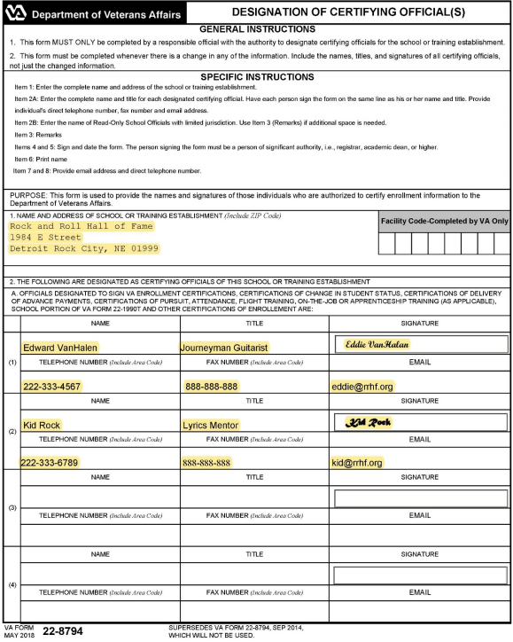
  22-8794

Slide 10
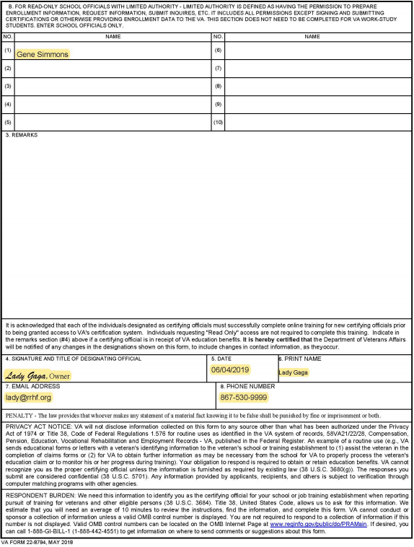
  22-8794

Slide 11
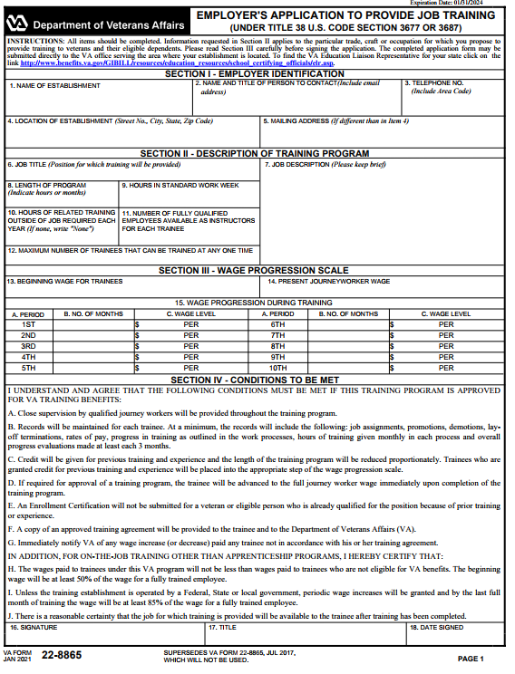
  22-8865

Slide 12
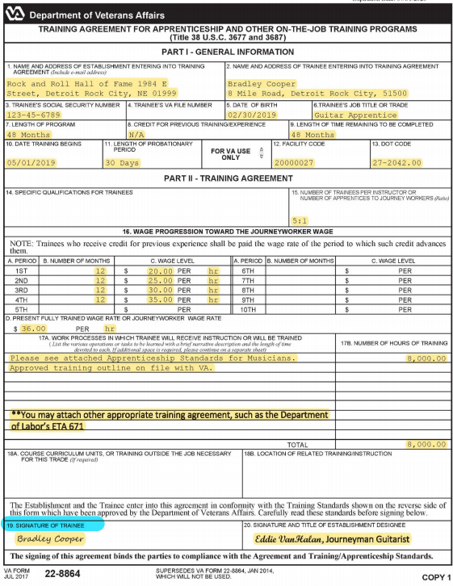
  22-8864

Slide 13
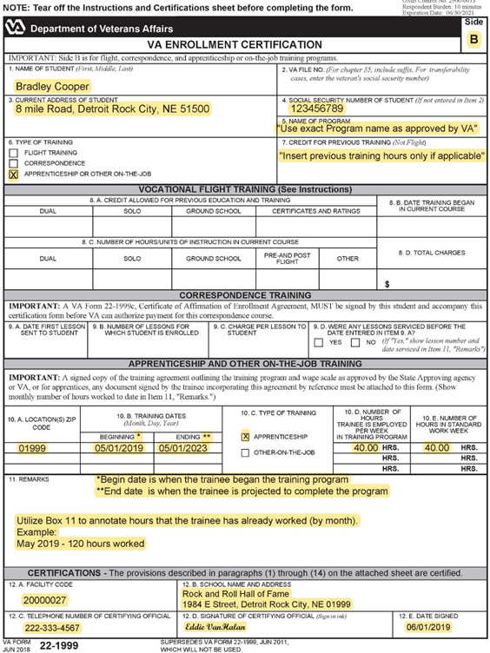
  22-1999

Slide 14
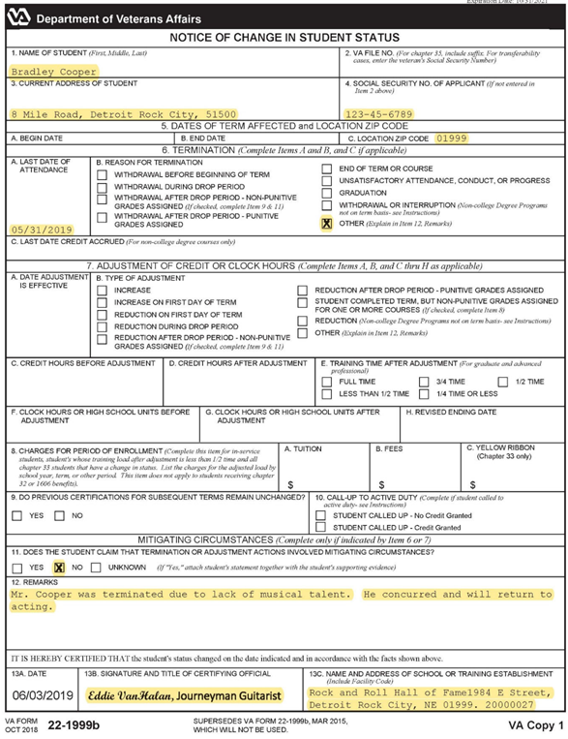
  22-1999b

Slide 15
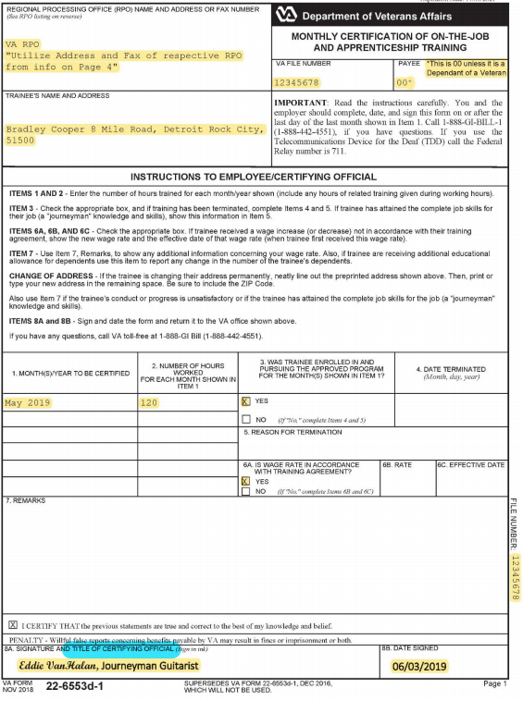
  22-6553d-1

Slide 16
Enrollment Manager
An individual at the employer must be assigned to be the Point of Contact to complete VA required training. The responsibility of the assigned individual is to update the State Approving Agency of any updates such as wage scale changes, length of training changes, new facility addresses, and apprenticeship standards. Additionally, the POC will certify monthly hours works/training at the end of each month using Enrollment Manager.

Slide 17
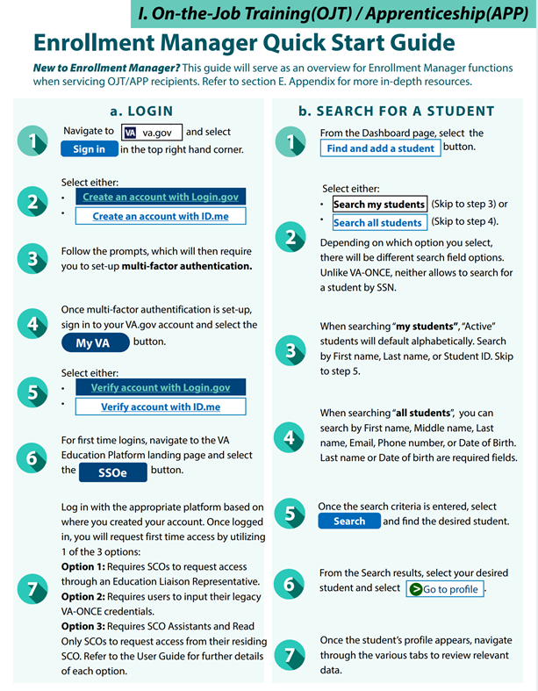

Slide 18
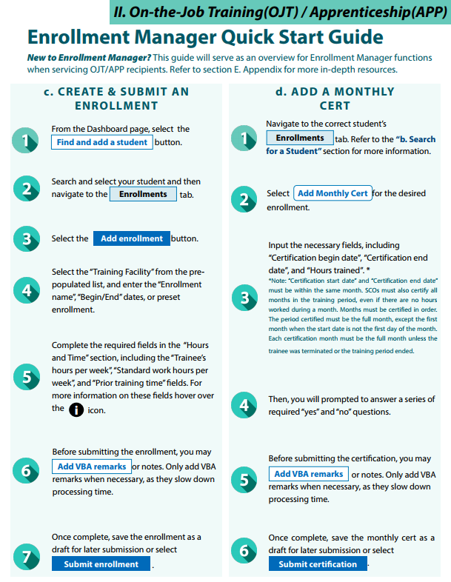

Slide 19
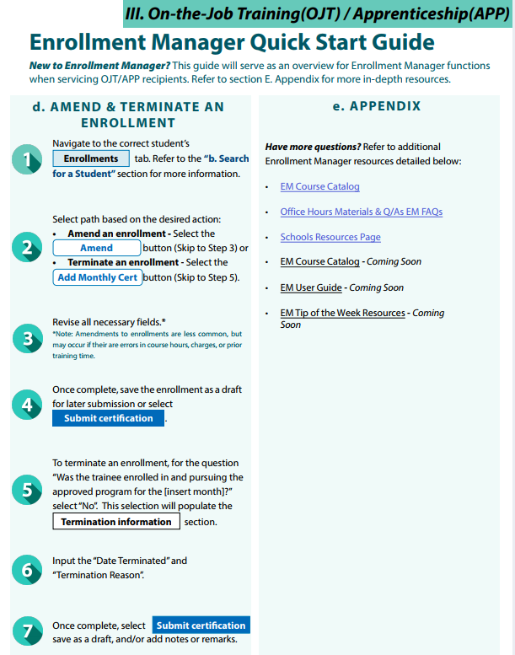

Slide 20
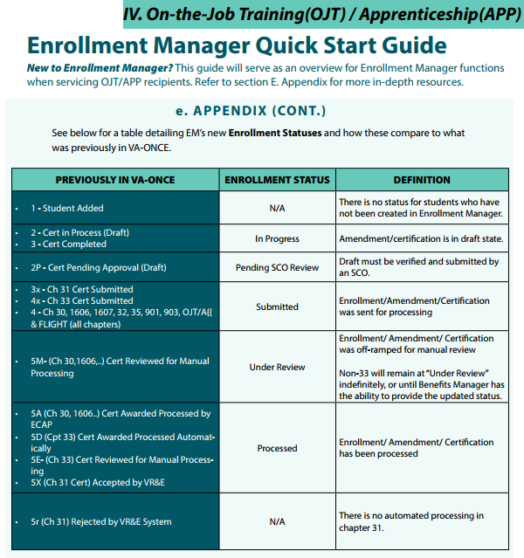

Slide 21
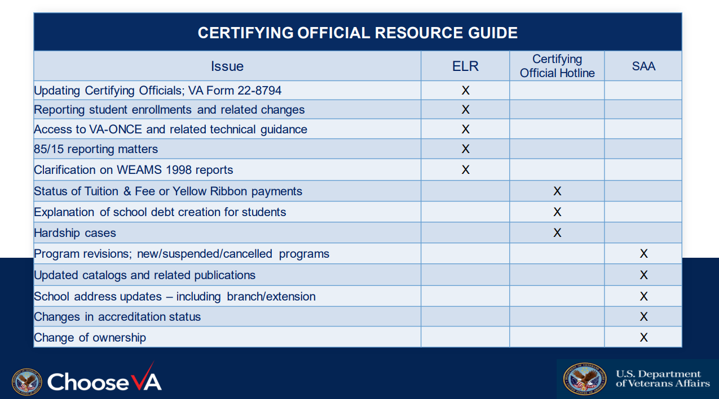

Slide 22
Resources
  SAA
  dvs.ohio.gov/jobs-and-education/state-approving-agency –
  dvs.ohio.gov/jobs-and-education/state-approving-agency/register-for-updates-saa –
  Association of Veterans Education Certifying Officials (AVECO)
  VA
  Benefits.va.gov/gibill
  GI Bill Hotline for students: 888-442-4551
  SCO Hotline: 855-225-1159
  School Certifying Official Handbook
  Ohio ELR: oh.elr.vbastl@va.gov
  public.govdelivery.com/accounts/USVAVBA/subscriber/new?preferences=true -

Slide 23
Ohio State Approving Agency
OhioSAA@dvs.ohio.gov

