Slide 1
Adapting WISE Pathways for your Community
OTN Learning Community 5.2.2023

Slide 2
About WISE Pathways
Originally developed to help women consider fast track training options that lead to good paying, in demand careers, with a focus on those where women remain significantly underrepresented. Designed to be easy to implement and customize to a region or industry sector, and for different audiences.
  What family-sustaining careers are available that I can access with fast-track training?
  What skills and knowledge do I need to do to compete successfully?
  Where can I get needed training and/or supportive services?
  How do I build a network of support to get in, stay in, and advance?
Notes:
Kaci will take it from here – what it does

Slide 3





WISE Pathways Program Objectives
Encourage women to consider careers in high demand, technical fields where women are underrepresented
Assist participants in determining their goals and next steps
Ensure participants understand application process, prepare for interviews, and find needed training
Offer relief to industries experiencing workforce gaps
Assist participants in identifying core life skills essential to success

Slide 4

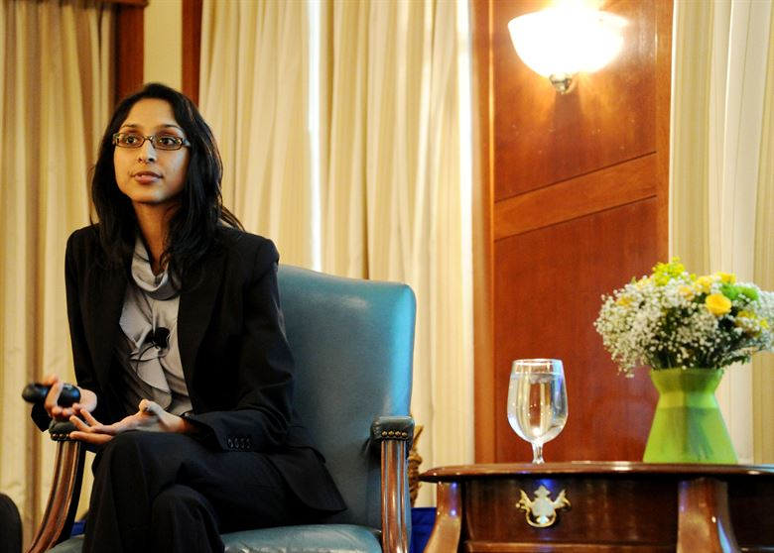
Primary Elements of WISE Pathways
Career Exploration and Coaching
Role Model Speakers

Slide 5







Current Industry Modules
Advanced
Manufacturing
Information
Technology
Logistics/Supply
Chain
Energy and Utility
Construction
Public Safety

Slide 6











Additional Program Components
Work Habits & Safety
Team Building
Resume Writing
Sexual Harassment
Financial Management
Applications
Technical Skills
Conflict Management
Interviewing & Networking
Assessment, Training, or Employment

Slide 7
WISE Pathways Adaptations
Case Studies

Slide 8
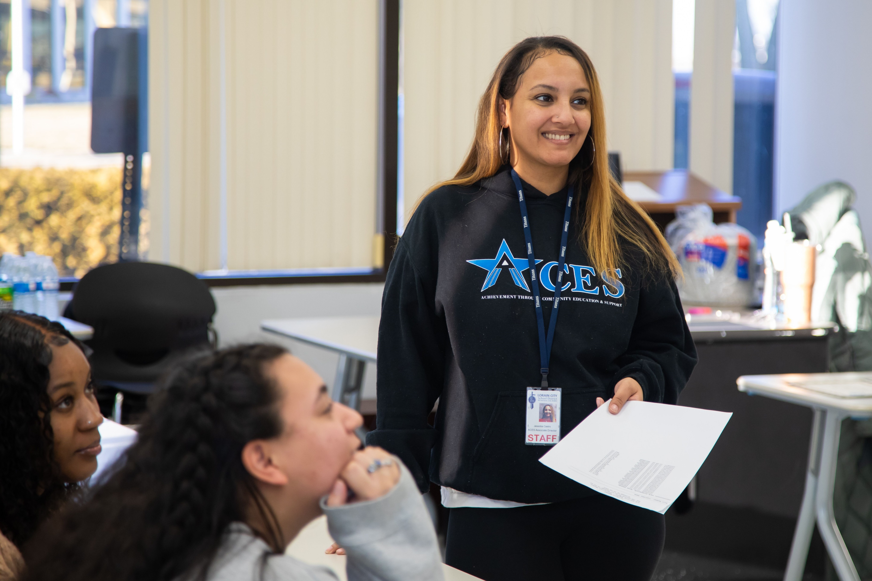
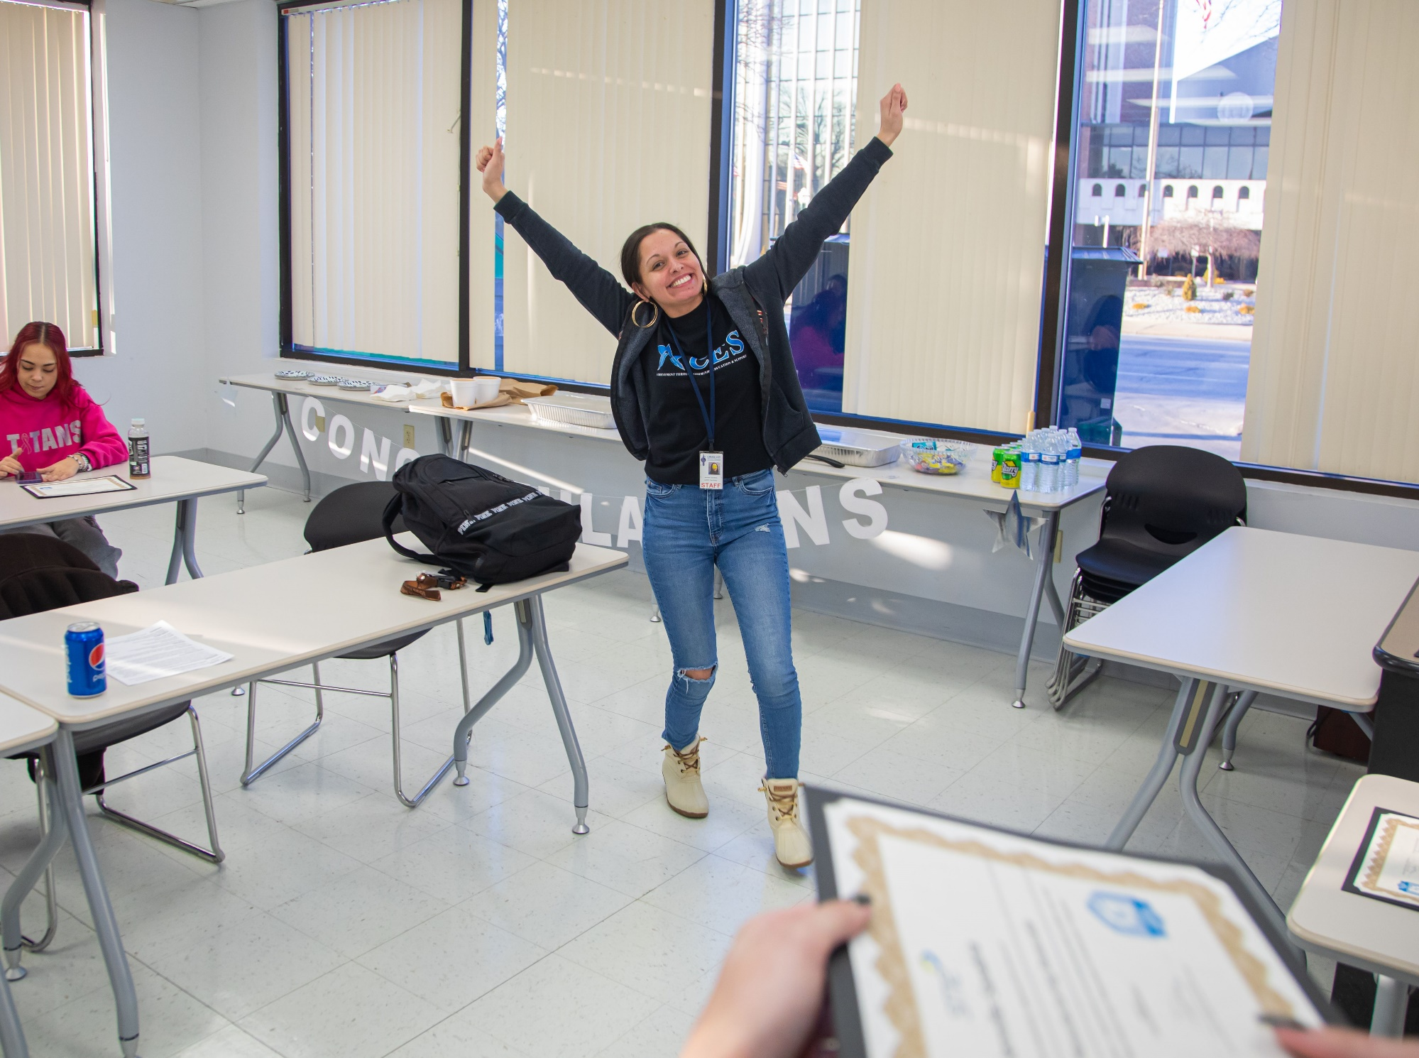
High School - LCCC
Pilot: Participants included high school juniors and seniors, and recent graduates
100% of participants earned a Certified Manufacturing Associate credential from Tooling U
HHW Ohio is working with the Lorain County Manufacturing Sector Partnership to organize summer internships and work experiences for program completers
Notes:
Kaci will update this with the 100% completion maybe more photos
And in notes will add detail on ages and what is happening next with these women and girls
What made it a success

Slide 9
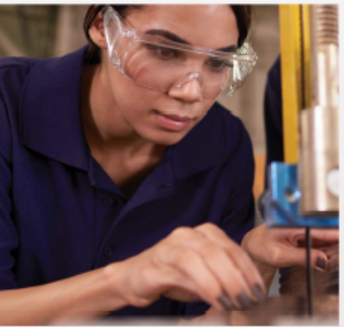
Women in Recovery- Shawnee State
Pilot: Participants are in recovery programs
100% of participants completed and are working with BESTOhio to explore earn and learn opportunities:
  Three participants were offered positions at local manufacturers
  One has enrolled in Shawnee State
Shawnee State and BESTOhio are expanding WISE to the Chillicothe campus and are planning two more cohorts on their Portsmouth campus

Slide 10
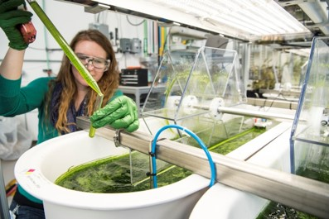
Curriculum Adaptations
ConxusNEO
First piloted ToolingU CMfgA integration
Developed Automotive Maintenance and Repair Module
North Central State- Crawford Success Center
Partnered with Crawford County Justice Center to use WISE Pathways as a diversion program
Developed Agricultural Module

Slide 11
Built to Adapt
Lessons learned from adaptations
Identify pockets of need in your community
Work to find mutual benefit with partners
Think creatively about capacity
Listen to the needs of industry
Be flexible and adapt
Build momentum
Share promising practices
Contextualizing WISE Pathways to your community

Slide 12
Future of WISE Pathways
Expanded Modules
New Industries
Military Family/ Vet Curriculum
Additional Certificate Integration
New Modes of Delivery
Foundational Components
Statewide (and potentially National) Capacity Building & Continued Impact Analysis
STEM and Technical Career Focused

